Slide 1

Designing of IoT Solutions
IoT Physical Devices & Endpoints
Charanraj B R
Department of Computer Science Engineering

Slide 2

Designing of Iot solutions
Raspberry Pi
Charanraj B R
Department of Computer Science Engineering

Slide 3
Designing of IoT Solution
Outline of Presentation
Raspberry Pi

Slide 4
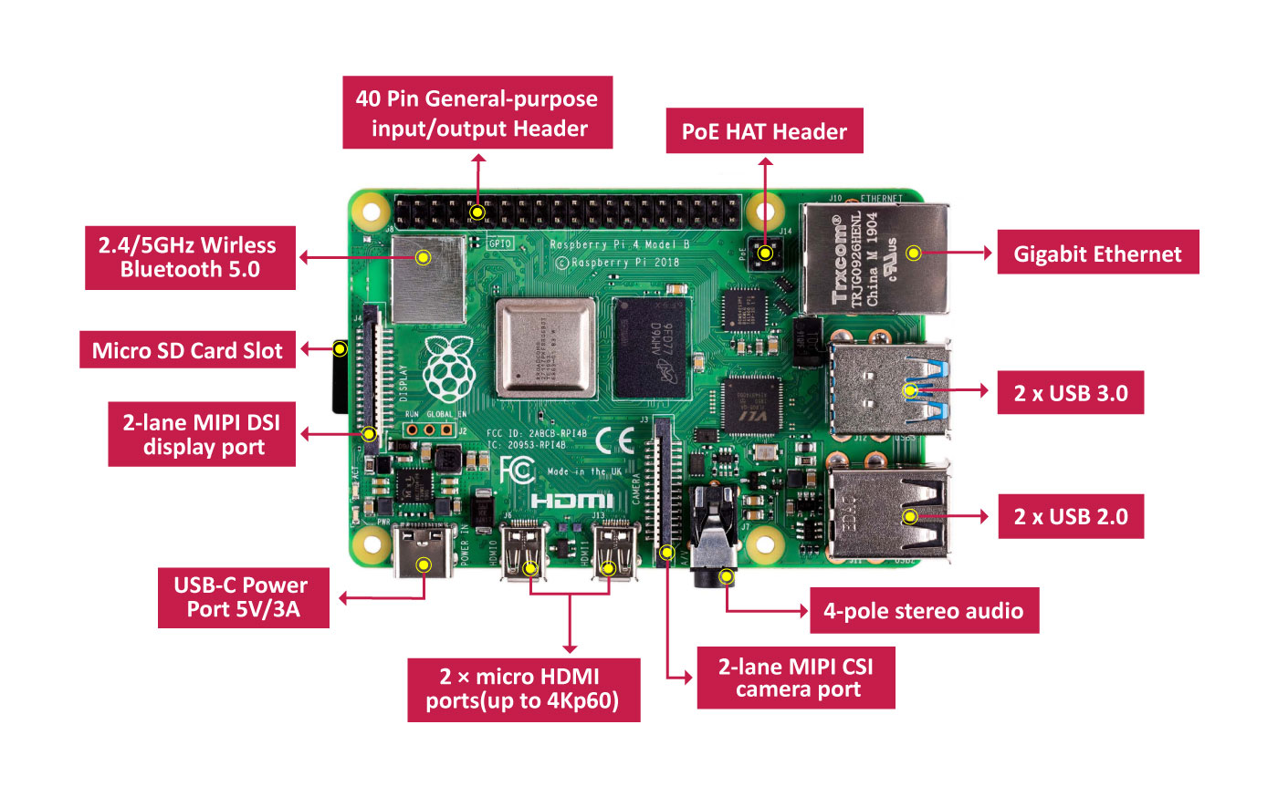
Designing of IoT Solution
Raspberry Pi

Slide 5
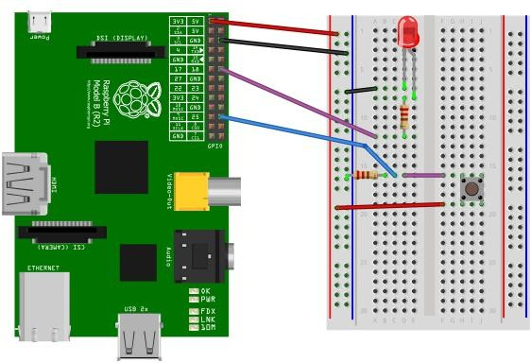
Designing of IoT Solution
Raspberry Pi Example : Interfacing LED and switch with Raspberry Pi
from time import sleep import RPi.GPIO as GPIO GPIO.setmode(GPIO.BCM)
#Switch Pin GPIO.setup(25, GPIO.IN) #LED Pin
GPIO.setup(18, GPIO.OUT)
state=false
def toggleLED(pin):
state = not state GPIO.output(pin, state)
while True:
try:
if (GPIO.input(25) == True): toggleLED(pin)
sleep(.01)
except KeyboardInterrupt: exit()

Slide 6
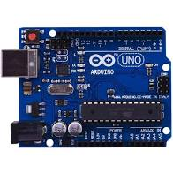
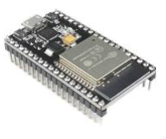
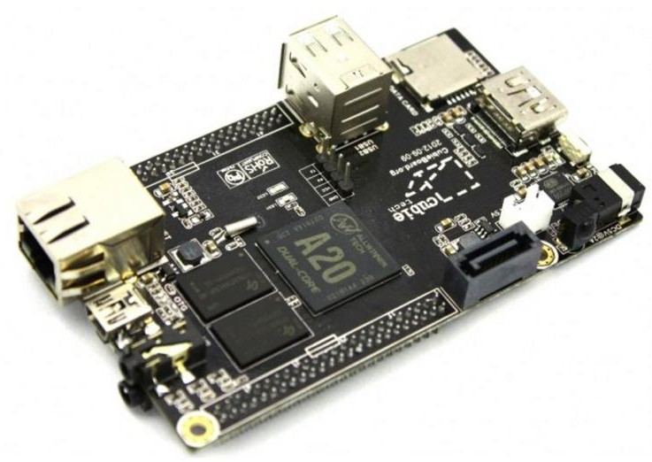
Designing of IoT Solution
Other Devices
Arduino
ESP32
Cubieboard

Slide 7
THANK YOU
Charanraj B R
Department of Computer Science Engineering
charanarajbr@pes.edu
+91 80 6666 3333 Extn 721

